Slide 1

Game Theory and Intelligent Orchestration: The honeypots case study
Big data and intelligent applications
University of western Macedonia
Christos Dalamagkas – cdalamagkas@uowm.gr
Prof. Panagiotis sarigiannidis – psarigiannidis@uowm.gr

Slide 2
Outline
Introduction to Honeypots
Purpose
Classification
Frameworks
Introduction to Game Theory
The Honeypots Case Study – One-shoot game
The maxmin approach
Results and discussion

Slide 3
Honeypots
Definition:
“An information system resource (e.g., a PC, a server, etc) whose values lies in unauthorized or illicit use of that resource” (Lance Spitzner - 2002)
Usage:
Act as decoy to lure cyberattackers
Goals:
Gather intelligence about current cyber threats → Feedback for improving the cyber security strategy of the organization
Consume attacker’s resources
Mislead them from targeting the real infrastructure

Slide 4
Honeypots Classification
Based on Physicality:
Virtual → e.g., virtual machine
Physical → e.g., a real device that is used only as honeypot
Based on Operation Field:
Production → Deployed in the operational environment to attract malicious insiders
Research → Deployed publicly on the Internet to attract cyberattackers or bots
Based on Role:
Server → Waits for connections
Client → Actively searchers for malicious servers that aim to lure clients
Hybrid → Combination of the above
Based on Interaction:
Low → Implements basic functionalities and can easily be detected, but cheaper
High → Fully functional systems, realistic but expensive to implement and maintain

Slide 5
Honeypot Frameworks
Conpot
Focuses on industrial protocols (Modbus TCP, S7Comm, BACnet, IPMI, EN/IP), also supports HTTP, SNMP, (T)FTP
Dionea
SSH Honeypot server
T-Pot by Deutsche Telekom
Honeypot suite, composed of multiple honeypot frameworks
A virtual machine that hosts multiple honeypots as docker containers
A dockerfile for each honeypot
https://www.honeynet.org/projects/

Slide 6
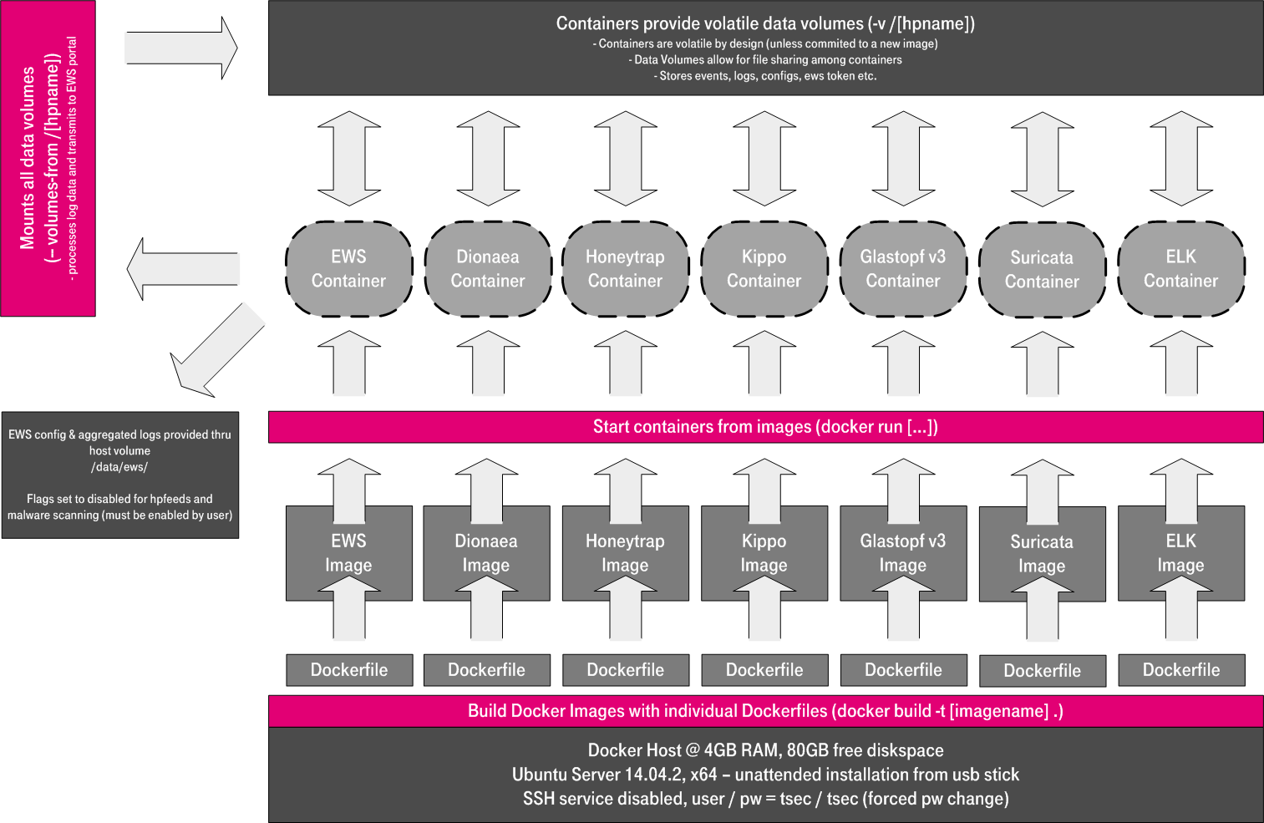
The T-Pot Framework
https://github.security.telekom.com/2015/03/honeypot-tpot-concept.html

Slide 7
Additional honeypot terminology
Honeynets:
A network of honeypots
“A network of high interaction honeypots that simulates a production network and configured such that all activity is monitored, recorded and in a degree, discreetly regulated” (Lance Spitzner – Honeynet Project)
Honeyfarm
A centralized collection of honeypots and analysis tools

Slide 8
Game Theory (GT) basics
Definition:
An interdisciplinary field that studies methods for optimal decision making, considering the decisions of competitors
A methodology for modelling and formulating decision-making problems
Applications in financials, politics, psychology, sociology, evolutionally biology, computer science
A game theory model is composed of:
Players
Strategies: Actions that are available for each player
Information about other player’s strategies/actions
Payoff or Utilities: Rules that describe the benefit or damage of a player, based on the action that they choose. Objective is to maximise the payoff/utility
GT objective: Find the variables (actions) that maximize the payoff function
Payoff: Function representing the benefit (positive or negative) of a strategy, considering the strategies chosen by the rest players
Utility: Function representing the benefit (positive or negative) of a strategy, regardless of the strategies chosen by the rest players

Slide 9
Game Categories ^{(1/2)}
Cooperative vs Non-cooperative
Cooperative → Players may form teams and exchange information in order to improve their payoff
Non-Cooperative → Each player works on their own
Constant Sum vs Zero Sum
Constant → The sum of the payoff enjoyed by all players is constant
Zero Sum → The sum of the payoff enjoyed by all players is always zero. This means that the benefit of a player results to an equal damage for another player
Finite or Infinite
Finite → The player can choose between a range of discrete strategies
Infinite → There is infinite number of strategies to be chosen
Stackelberg games: One player (leader) moves first and all other players (followers) move after them

Slide 10
Game Categories ^{(2/2)}
Depending on the game category, we know how to solve it
Simultaneous vs Sequential Moves:
Simultaneous → The players choose their strategy at the same time
Sequential → Each player waits for their round
Mixed or Pure Strategy
Pure → Players chose their strategy in a deterministic manner
Mixed → Players choose their strategy based on probabilities (stochastic)
Perfect vs Imperfect Information
Perfect → The player has perfect information about the strategies and payoffs of the other players
Imperfect → The player has incomplete information about the strategies and payoffs of the other players. Usually, the player tries to estimate the payoff function based on probabilities (Bayesian game)
There are more categories

Slide 11
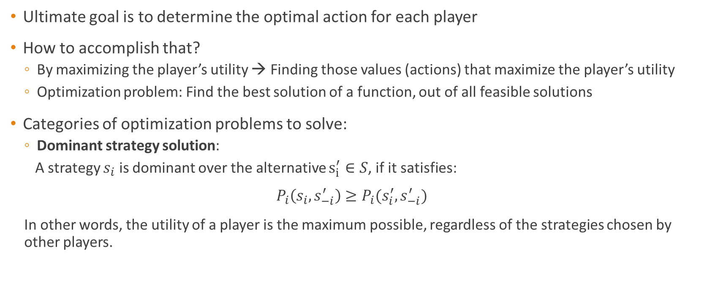
Solutions in GT models
Ultimate goal is to determine the optimal action for each player
How to accomplish that?
By maximizing the player’s utility → Finding those values (actions) that maximize the player’s utility
Optimization problem: Find the best solution of a function, out of all feasible solutions
Categories of optimization problems to solve:
Dominant strategy solution:
A strategy $s_{i}$ is dominant over the alternative $s_{i}^{′}∈S$, if it satisfies:
$$P_{i}\left(s_{i}, s_{−i}^{′}\right)≥P_{i}(s_{i}^{′}, s_{−i}^{′})$$
In other words, the utility of a player is the maximum possible, regardless of the strategies chosen by other players.

Slide 12
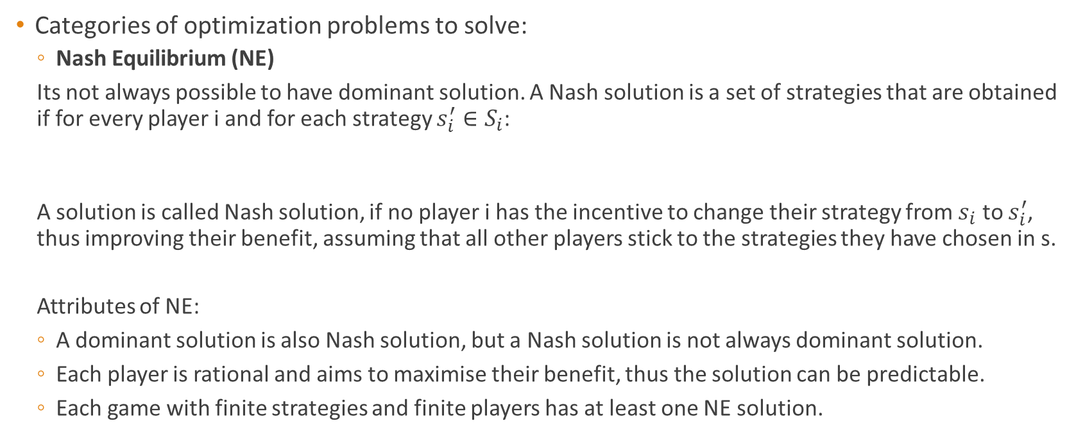
Solutions in GT models
Categories of optimization problems to solve:
Nash Equilibrium (NE)
Its not always possible to have dominant solution. A Nash solution is a set of strategies that are obtained if for every player i and for each strategy $s_{i}^{′}∈S_{i}$:
A solution is called Nash solution, if no player i has the incentive to change their strategy from $s_{i}$ to $s_{i}^{′}$, thus improving their benefit, assuming that all other players stick to the strategies they have chosen in s.
Attributes of NE:
A dominant solution is also Nash solution, but a Nash solution is not always dominant solution.
Each player is rational and aims to maximise their benefit, thus the solution can be predictable.
Each game with finite strategies and finite players has at least one NE solution.
$$P_{i}\left(s_{i},s_{−i}\right)≥P_{i}(s_{i}^{′},s_{−i})$$

Slide 13
Is NE always the best solution?
NE is a rational outcome, considering a finite, non-cooperative game and the fact that each player is “selfish”
But its always the best possible solution? Let's take the prisoner’s dilemma:
Two members of a criminal gang are arrested and imprisoned. Each prisoner is in solitary confinement with no means of communicating with the other. The prosecutors lack sufficient evidence to convict the pair on the principal charge, but they have enough to convict both on a lesser charge. Simultaneously, the prosecutors offer each prisoner a bargain. Each prisoner is given the opportunity either to betray the other by testifying that the other committed the crime, or to cooperate with the other by remaining silent

Slide 14
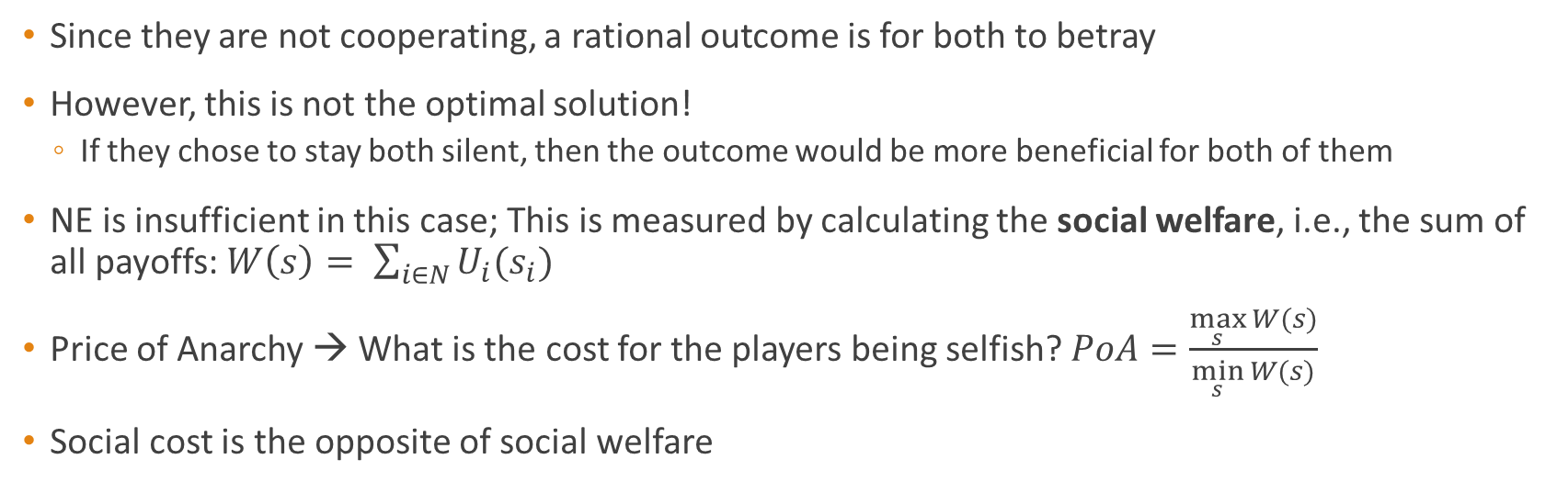
Prisoner’s dilemma outcomes
 | B betrays | B stays silent
A betrays | (-3, -3) | (0, -4)
A stays silent | (-4, 0) | (-1, -1)
Since they are not cooperating, a rational outcome is for both to betray
However, this is not the optimal solution!
If they chose to stay both silent, then the outcome would be more beneficial for both of them
NE is insufficient in this case; This is measured by calculating the social welfare, i.e., the sum of all payoffs: $W\left(s\right)= \sum_{i∈N}{U_{i}(s_{i})}$
Price of Anarchy → What is the cost for the players being selfish? $PoA=\frac{\max_{s}{W(s)}}{\min_{s}{W(s)}}$
Social cost is the opposite of social welfare

Slide 15
The Honeypots Case Study
How many honeypots should the organization choose to deploy?
Large number of honeypots waste computing resources
Small number of honeypots is not adequate to capture attackers or to be detected, thus the risk is increased
Game theory can help us take a decision:
We have contradicting interests; the defender wants to receive attackers at honeypots and the attacker wants to target as many real devices as possible
The number of honeypots should be minimized so that the interest of the defender is maximized, while the attacker takes always the right decisions
Game players:
Defender → The system administrator of the organization under attack
Attacker → Malicious insider or cyberattacker over the Internet that aims at the assets of the defender

Slide 16
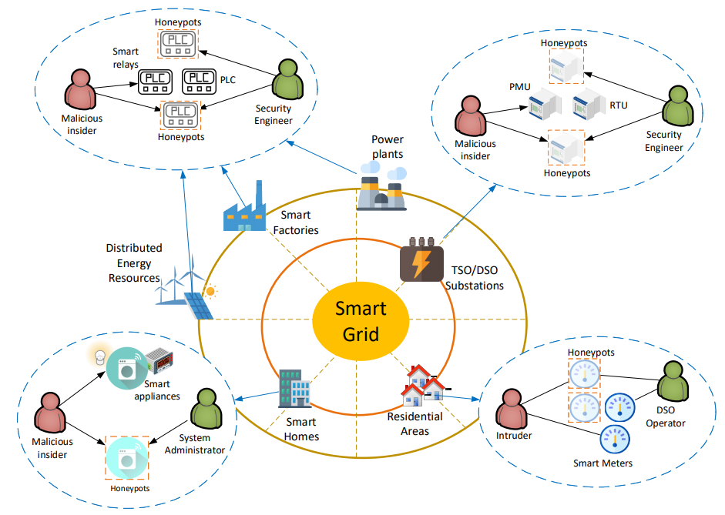
Smart Grid Honeypots
Example of honeypots location in a smart grid environment
A honeypot could be located in:
Smart home
Smart meters of residential areas
In digitalized substations
In smart factories
In Renewables plants

Slide 17
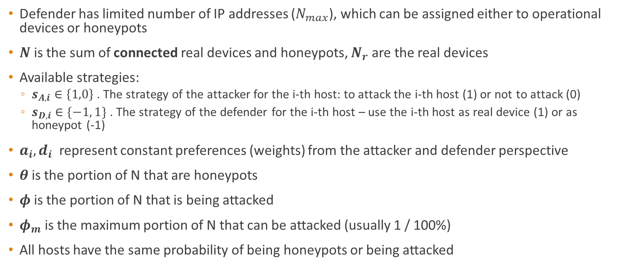
Game Rules
Defender has limited number of IP addresses ($N_{max}$), which can be assigned either to operational devices or honeypots
$N$ is the sum of connected real devices and honeypots, $N_{r}$ are the real devices
Available strategies:
$s_{A,i}∈\left\{1,0\right\}$ . The strategy of the attacker for the i-th host: to attack the i-th host (1) or not to attack (0)
$s_{D,i}∈\{−1, 1\}$ . The strategy of the defender for the i-th host – use the i-th host as real device (1) or as honeypot (-1)
$a_{i}, d_{i}$ represent constant preferences (weights) from the attacker and defender perspective
$θ$is the portion of N that are honeypots
$φ$is the portion of N that is being attacked
$φ_{m}$ is the maximum portion of N that can be attacked (usually 1 / 100%)
All hosts have the same probability of being honeypots or being attacked

Slide 18
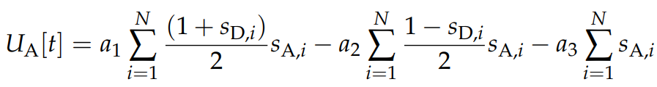
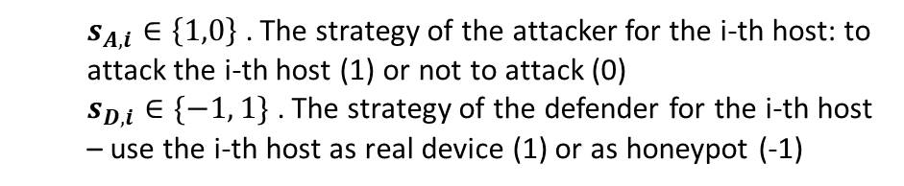
Initial Utility Functions
$s_{A,i}∈\left\{1,0\right\}$ . The strategy of the attacker for the i-th host: to attack the i-th host (1) or not to attack (0)
$s_{D,i}∈\{−1, 1\}$ . The strategy of the defender for the i-th host – use the i-th host as real device (1) or as honeypot (-1)
damage for attacking honeypots
damage for total number of attacks
benefit for attacking real devices
damage for the total number of hosts
damage for real devices being attacked
damage for real devices not served
benefit for honeypots being attacked

Slide 19
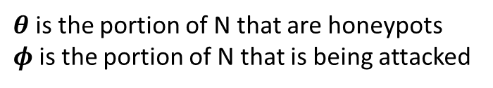
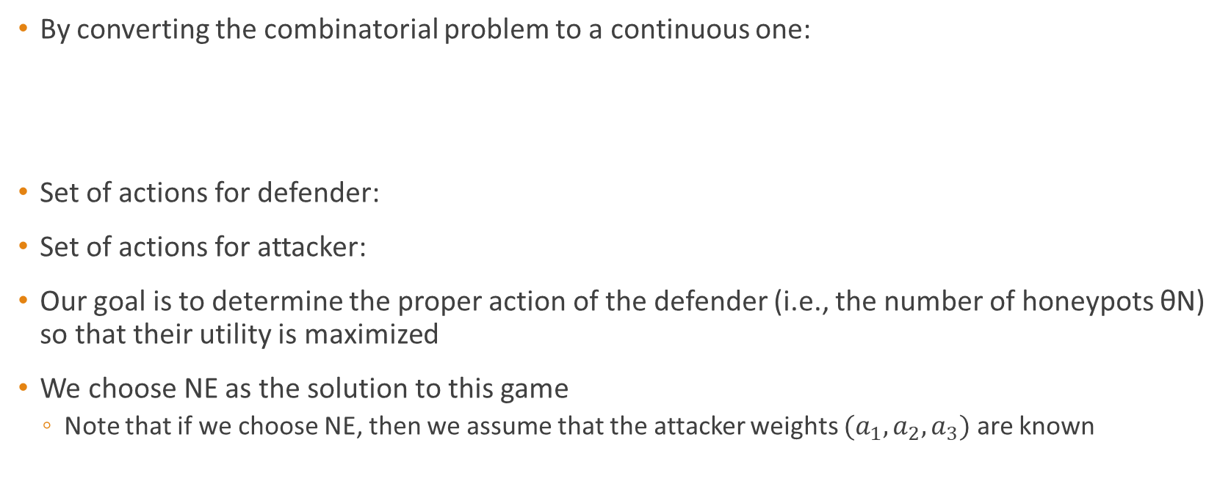


One-Shot Game Definition
$θ$is the portion of N that are honeypots
$φ$is the portion of N that is being attacked
By converting the combinatorial problem to a continuous one:
Set of actions for defender:
Set of actions for attacker:
Our goal is to determine the proper action of the defender (i.e., the number of honeypots θΝ) so that their utility is maximized
We choose NE as the solution to this game
Note that if we choose NE, then we assume that the attacker weights $(a_{1},a_{2}, a_{3})$ are known
$$U_{A}=a_{1}\left(1−θ\right)Nφ−a_{2}θφN−a_{3}φN$$
$$U_{D}=d_{1}θφN−d_{2}\left(1−θ\right)Nφ−d_{3}{\left(\left(1−θ\right)N−N_{r}\right)}^{2})−d_{4}N$$
$$A_{D}=\{θ∈\left[0,1\right], N∈\left[0,N_{max}\right]\}$$
$$A_{A}=φ∈[0,φ_{m}]$$

Slide 20
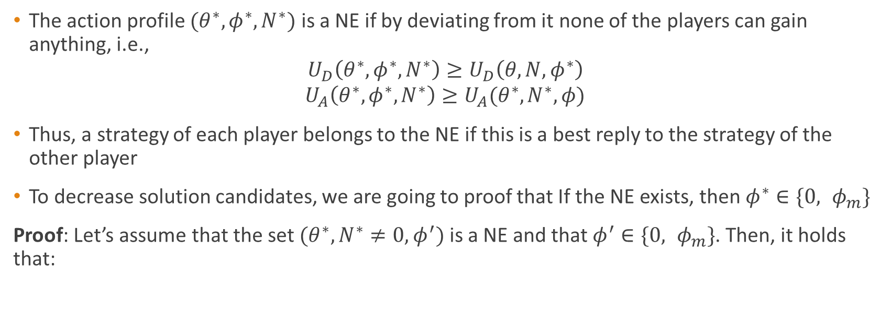
One-Shot Game – NE Definition
The action profile $(θ^{∗}, φ^{∗},N^{∗})$ is a NE if by deviating from it none of the players can gain anything, i.e.,
$$U_{D}\left(θ^{∗}, φ^{∗},N^{∗}\right)≥U_{D}\left(θ, N, φ^{∗}\right)$$
$$U_{A}\left(θ^{∗}, φ^{∗},N^{∗}\right)≥U_{A}(θ^{∗}, N^{∗}, φ)$$
Thus, a strategy of each player belongs to the NE if this is a best reply to the strategy of the other player
To decrease solution candidates, we are going to proof that If the NE exists, then ${φ^{∗}∈\{0, φ}_{m}\}$
Proof: Let’s assume that the set $(θ^{∗}, N^{∗}≠0, φ^{′})$ is a NE and that ${φ^{′}∈\{0, φ}_{m}\}$. Then, it holds that:
$${{(a_{1}\left(1−θ\right)N−a_{2}θN−a_{3}N)φ}^{′}≥(a_{1}\left(1−θ\right)−a_{2}θ−a_{3})φ}_{m}$$
This results to ${φ^{′}≥ φ}_{m}$, which contradicts the assumption.

Slide 21
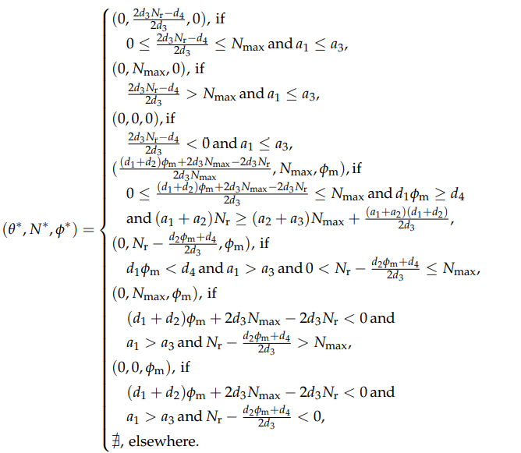

NE of the One-Shoot Game
The possible NEs are derived by setting optimal values for $φ$ or $N$ and solving the derivatives $U_{D}^{′}=0$ and $U_{A}^{′}=0$respectively.
For specific problem parameters, the NE (is exists):
Is unique
Is located at the global maximum
The fourth branch is the most appropriate solution, since:
${N=N}_{max}$
${φ=φ}_{m}$
$0<θ<1$

Slide 22
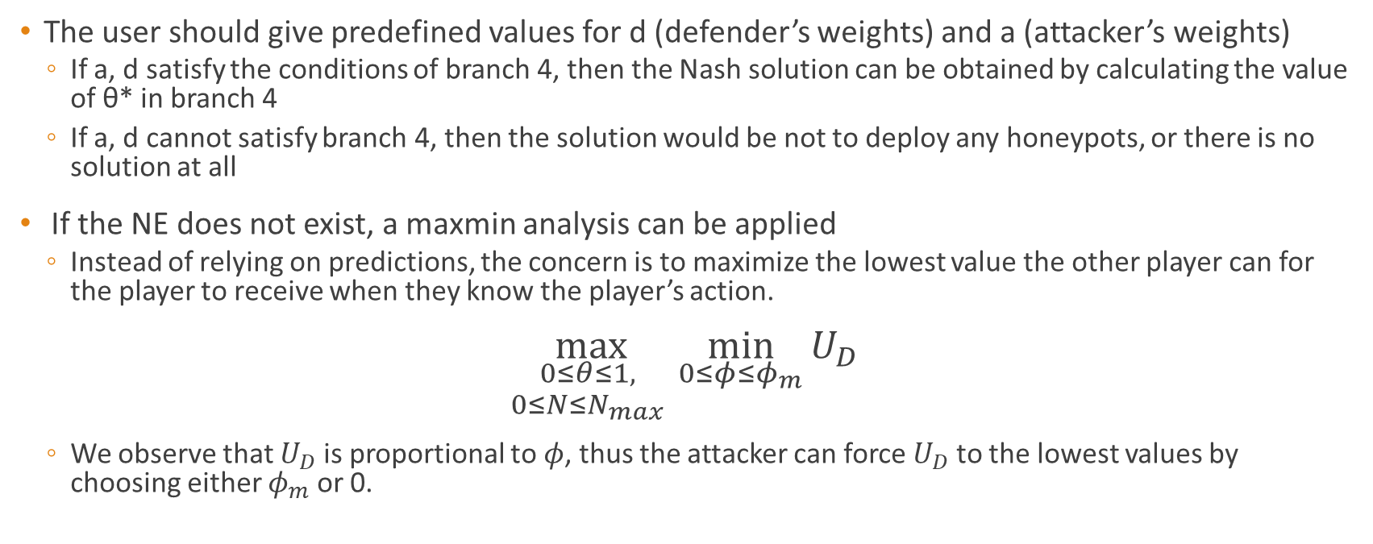
What if NE does not exist?
The user should give predefined values for d (defender’s weights) and a (attacker’s weights)
If a, d satisfy the conditions of branch 4, then the Nash solution can be obtained by calculating the value of θ* in branch 4
If a, d cannot satisfy branch 4, then the solution would be not to deploy any honeypots, or there is no solution at all
If the NE does not exist, a maxmin analysis can be applied
Instead of relying on predictions, the concern is to maximize the lowest value the other player can for the player to receive when they know the player’s action.
$$\max_{\begin{aligned}0≤θ≤1, \\ 0≤N≤N_{max} \end{aligned}}{\min_{0≤φ≤φ_{m}}{U_{D}}}$$
We observe that $U_{D}$ is proportional to $φ$, thus the attacker can force $U_{D}$ to the lowest values by choosing either $φ_{m}$ or 0.

Slide 23
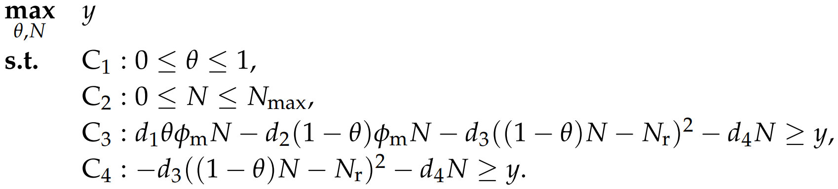
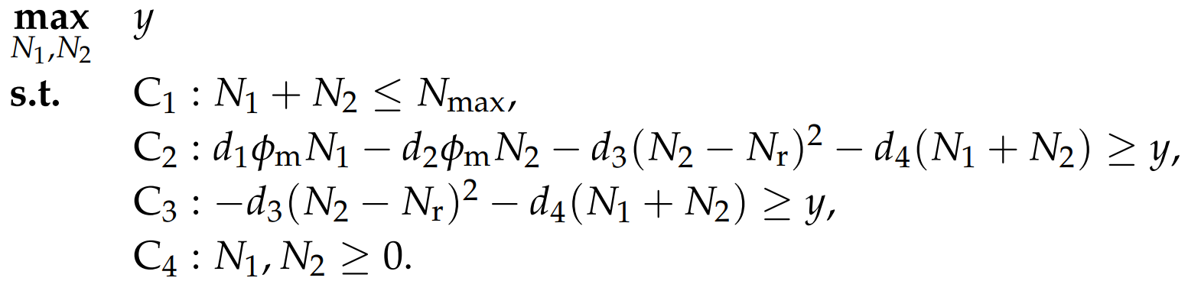
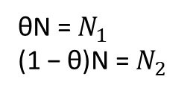

The maxmin optimization problem
convex = only one optimal solution which is globally optimized
When ${φ=φ}_{m}$
When $φ=0$
Thus, the optimization problem is formulated as follows:
θN = $N_{1}$
(1 − θ)N = $N_{2}$
non-convex
convex

Slide 24
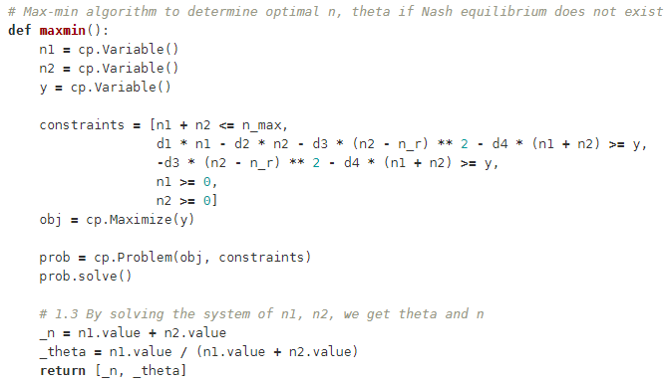
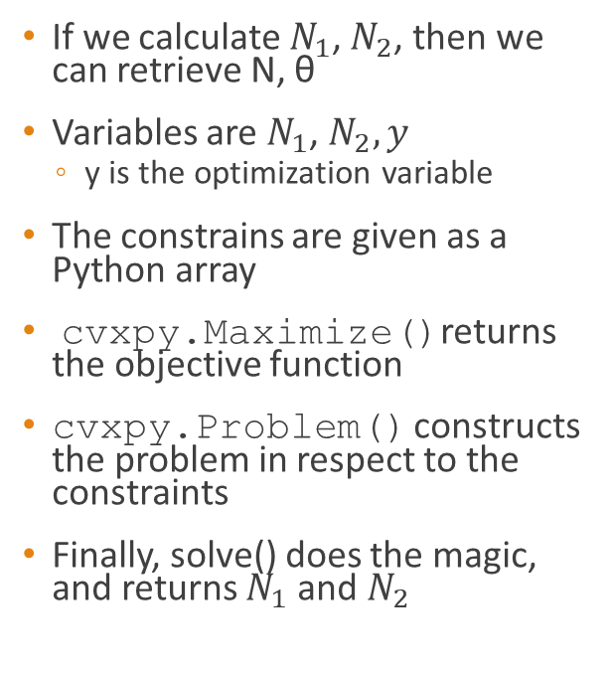
Solving convex problems in Python
Other ways to solve difficult constrained optimization problems: Lagrangian relaxation, genetic algorithms, etc
If we calculate $N_{1}$, $N_{2}$, then we can retrieve N, θ
Variables are $N_{1}$, $N_{2}, y$
y is the optimization variable
The constrains are given as a Python array
cvxpy.Maximize()returns the objective function
cvxpy.Problem() constructs the problem in respect to the constraints
Finally, solve() does the magic, and returns $N_{1}$ and $N_{2}$

Slide 25
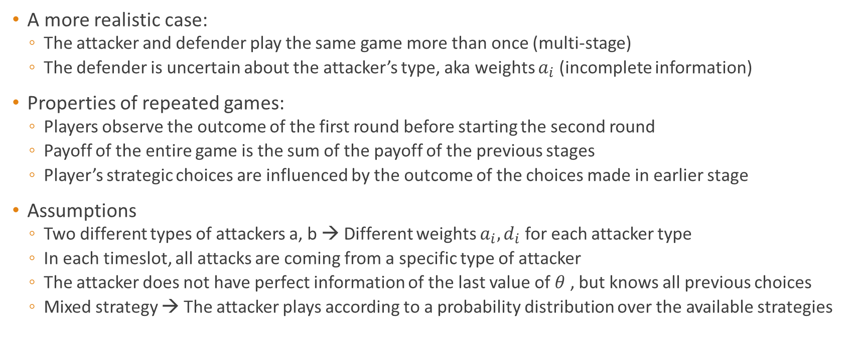
Multi-stage Game with Observed Actions and Incomplete Information
A more realistic case:
The attacker and defender play the same game more than once (multi-stage)
The defender is uncertain about the attacker’s type, aka weights $a_{i}$ (incomplete information)
Properties of repeated games:
Players observe the outcome of the first round before starting the second round
Payoff of the entire game is the sum of the payoff of the previous stages
Player’s strategic choices are influenced by the outcome of the choices made in earlier stage
Assumptions
Two different types of attackers a, b → Different weights $a_{i}, d_{i}$ for each attacker type
In each timeslot, all attacks are coming from a specific type of attacker
The attacker does not have perfect information of the last value of $θ$ , but knows all previous choices
Mixed strategy → The attacker plays according to a probability distribution over the available strategies

Slide 26
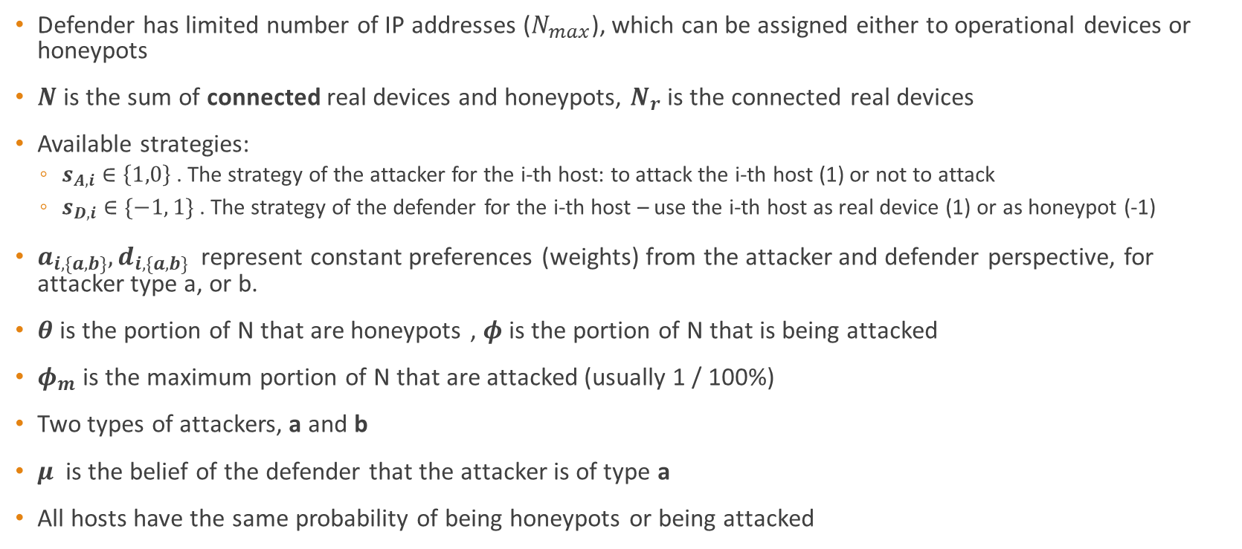
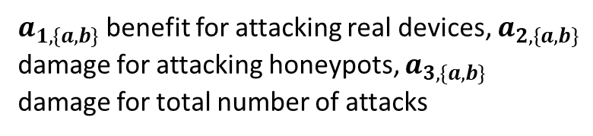
Multi-stage Game Rules
$d_{1,\{a,b\}}$damage for real devices being attacked, $d_{2,\{a,b\}}$ benefit for honeypots being attacked, $d_{3,\{a,b\}}$damage for real devices not served, $d_{4,\{a,b\}}$damage for the total number of hosts
$a_{1,\{a,b\}}$benefit for attacking real devices, $a_{2,\{a,b\}}$ damage for attacking honeypots, $a_{3,\{a,b\}}$ damage for total number of attacks
Defender has limited number of IP addresses ($N_{max}$), which can be assigned either to operational devices or honeypots
$N$ is the sum of connected real devices and honeypots, $N_{r}$ is the connected real devices
Available strategies:
$s_{A,i}∈\left\{1,0\right\}$ . The strategy of the attacker for the i-th host: to attack the i-th host (1) or not to attack
$s_{D,i}∈\{−1, 1\}$ . The strategy of the defender for the i-th host – use the i-th host as real device (1) or as honeypot (-1)
$a_{i,\{a,b\}}, d_{i,\{a,b\}}$ represent constant preferences (weights) from the attacker and defender perspective, for attacker type a, or b.
$θ$is the portion of N that are honeypots , $φ$is the portion of N that is being attacked
$φ_{m}$ is the maximum portion of N that are attacked (usually 1 / 100%)
Two types of attackers, a and b
$μ$ is the belief of the defender that the attacker is of type a
All hosts have the same probability of being honeypots or being attacked

Slide 27
Payoffs
$$𝔼\left[U_{A_{i}}\right]=a_{1,i},\left(1−θ\right)φ_{i}N−a_{2,i}θφ_{i}N−a_{3,i}φ_{i}N$$

Slide 28
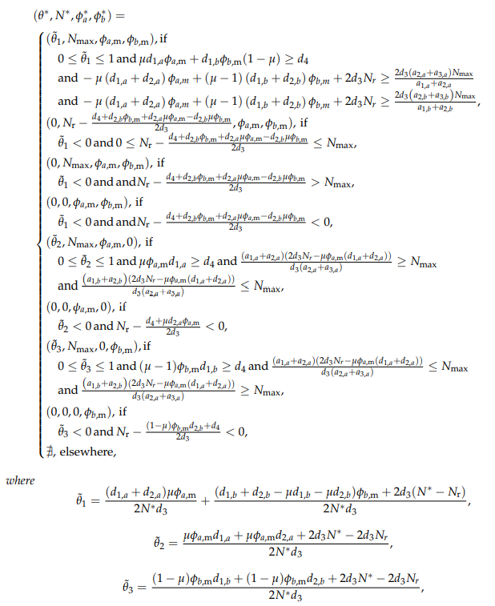
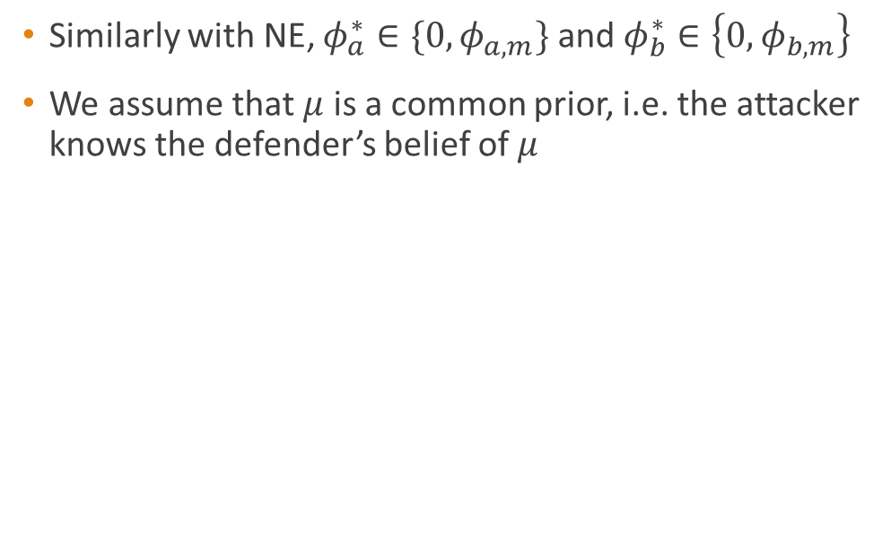
Bayesian NE (BNE)
Similarly with NE, $φ_{a}^{∗}∈\{0,φ_{a,m}\}$ and $φ_{b}^{∗}∈\left\{0,φ_{b,m}\right\}$
We assume that $μ$ is a common prior, i.e. the attacker knows the defender’s belief of $μ$

Slide 29
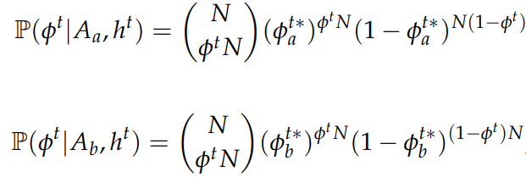
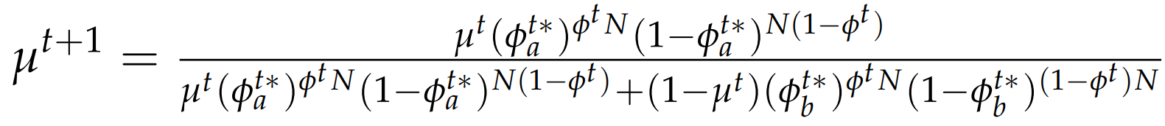
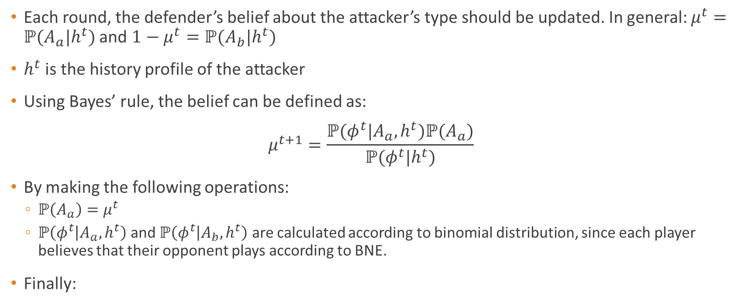
Update of belief
Each round, the defender’s belief about the attacker’s type should be updated. In general: $μ^{t}=ℙ(A_{a}|h^{t})$ and ${1−μ}^{t}=ℙ(A_{b}|h^{t})$
$h^{t}$ is the history profile of the attacker
Using Bayes’ rule, the belief can be defined as:
$$μ^{t+1}=\frac{ℙ(φ^{t}|A_{a},h^{t})ℙ(A_{a})}{ℙ(φ^{t}|h^{t})}$$
By making the following operations:
$ℙ\left(A_{a}\right)=μ^{t}$
$ℙ\left(φ^{t} | A_{a},h^{t}\right)$ and $ℙ\left(φ^{t} | A_{b},h^{t}\right)$ are calculated according to binomial distribution, since each player believes that their opponent plays according to BNE.
Finally:

Slide 30
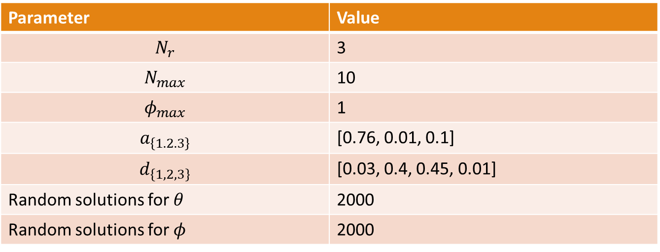
Experiment Setup
Comparing the NE for the attacker and the defender with 2000 random solutions to verify that the NE yields the maximum payoff, whilst the opponent always chooses the best strategy
Parameter | Value
$$N_{r}$$ | 3
$$N_{max}$$ | 10
$$φ_{max}$$ | 1
$$a_{\left\{1.2.3\right\}}$$ | [0.76, 0.01, 0.1]
$$d_{\left\{1,2,3\right\}}$$ | [0.03, 0.4, 0.45, 0.01]
Random solutions for $θ$ | 2000
Random solutions for $φ$ | 2000

Slide 31
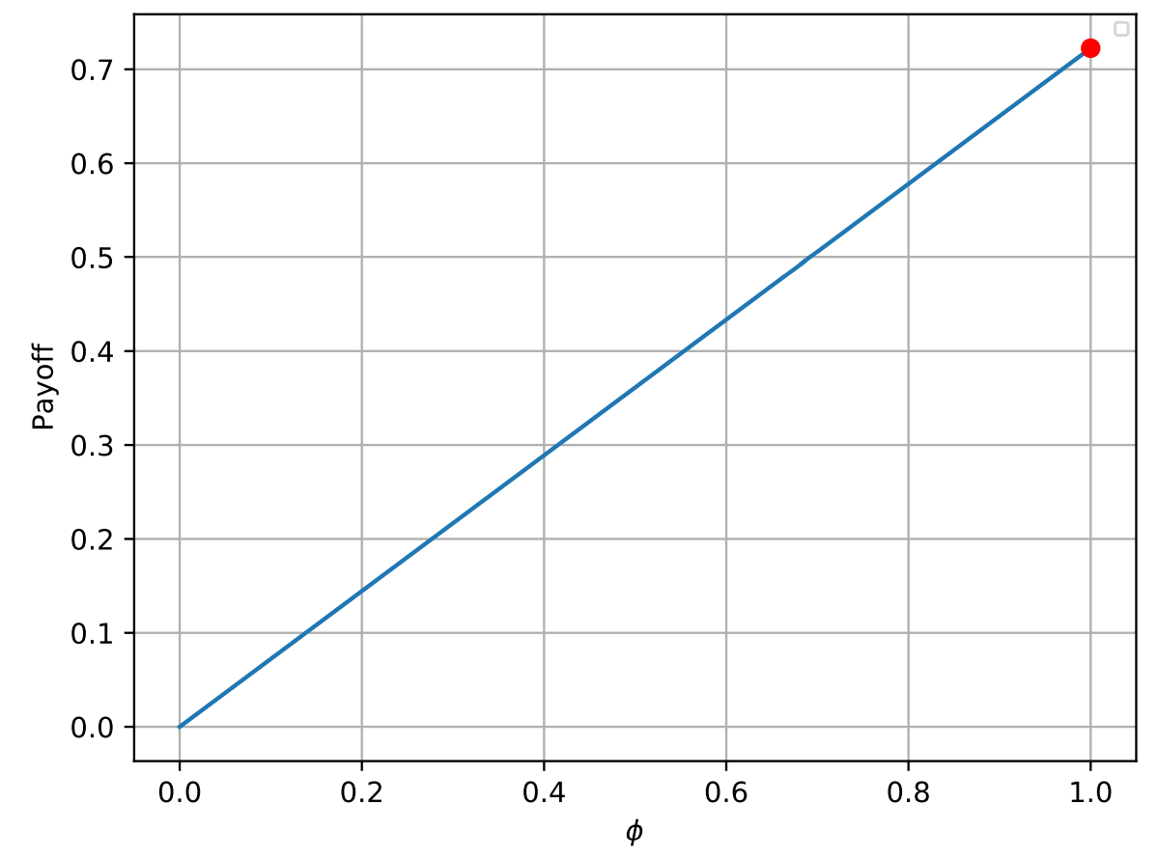
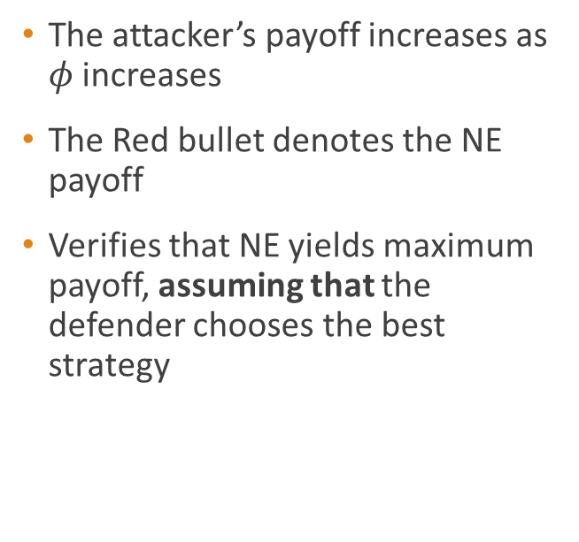
Attacker’s Payoff
The attacker’s payoff increases as $φ$ increases
The Red bullet denotes the NE payoff
Verifies that NE yields maximum payoff, assuming that the defender chooses the best strategy

Slide 32
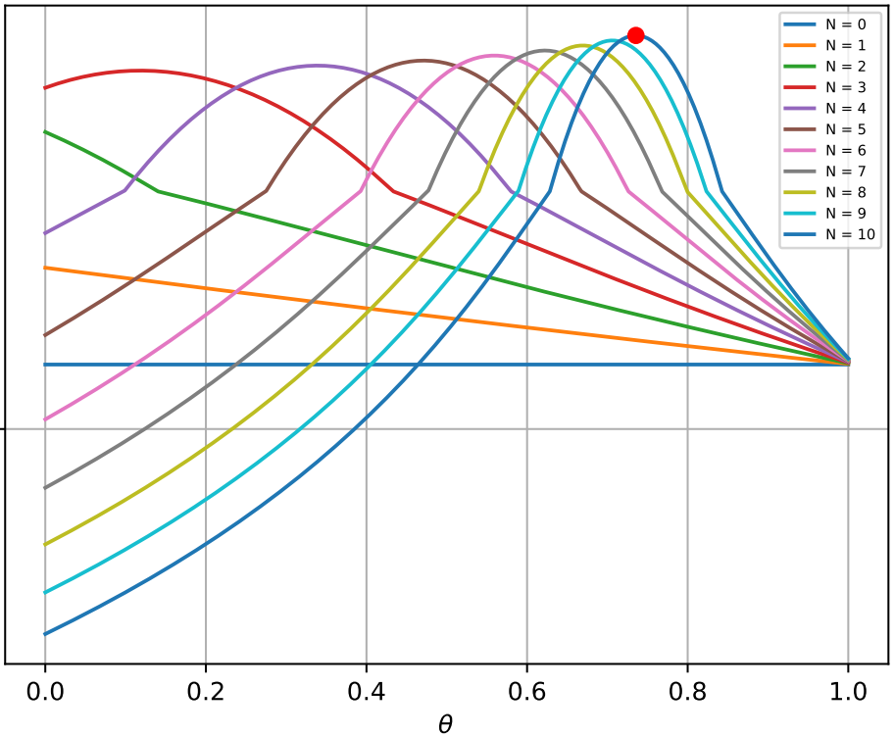
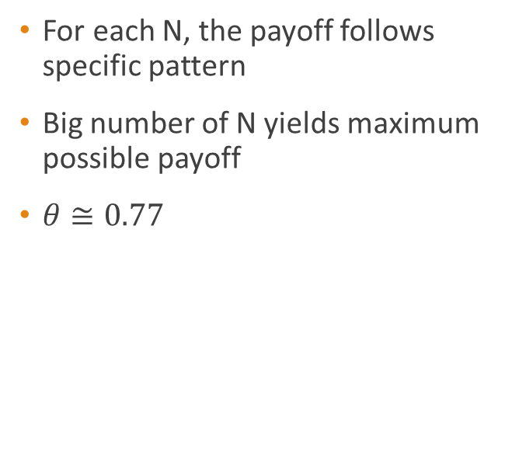
Defender’s Payoff
For each N, the payoff follows specific pattern
Big number of N yields maximum possible payoff
$θ≅0.77$

Slide 33
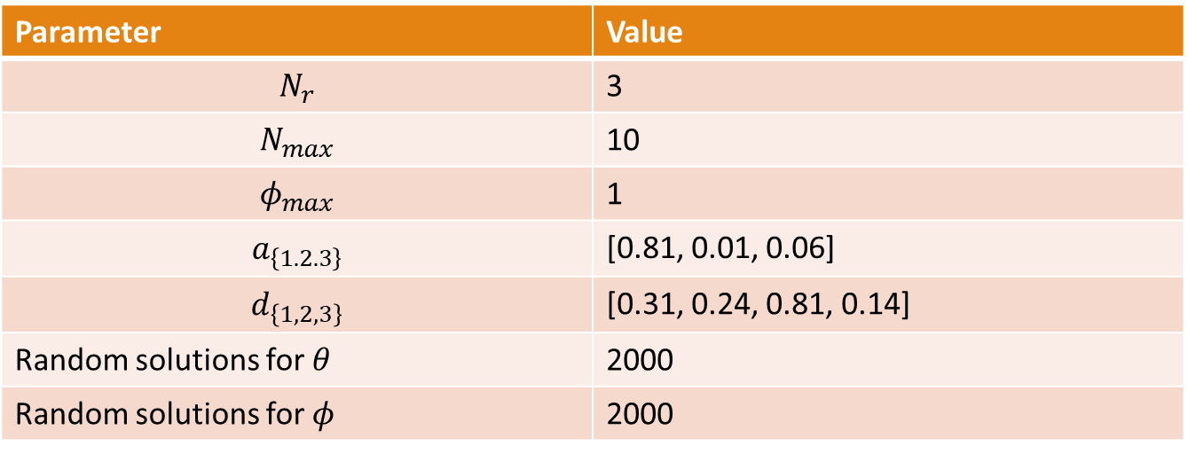
Experiment Setup - When NE does not exist
Comparing the NE for the attacker and the defender with 2000 random solutions to verify that the NE yields the maximum payoff, whilst the opponent always chooses the best strategy
Parameter | Value
$$N_{r}$$ | 3
$$N_{max}$$ | 10
$$φ_{max}$$ | 1
$$a_{\left\{1.2.3\right\}}$$ | [0.81, 0.01, 0.06]
$$d_{\left\{1,2,3\right\}}$$ | [0.31, 0.24, 0.81, 0.14]
Random solutions for $θ$ | 2000
Random solutions for $φ$ | 2000

Slide 34
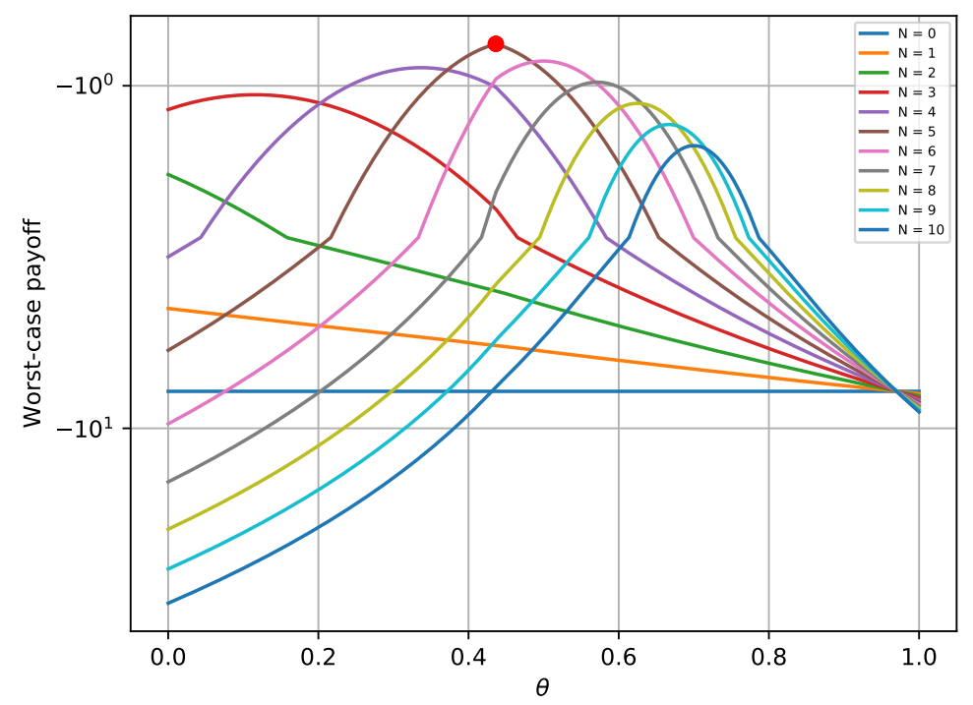

Maxmin Payoff
Great N does not guarantee maximum payoff
$N^{∗}=5$
$θ≅0.42$

Slide 35
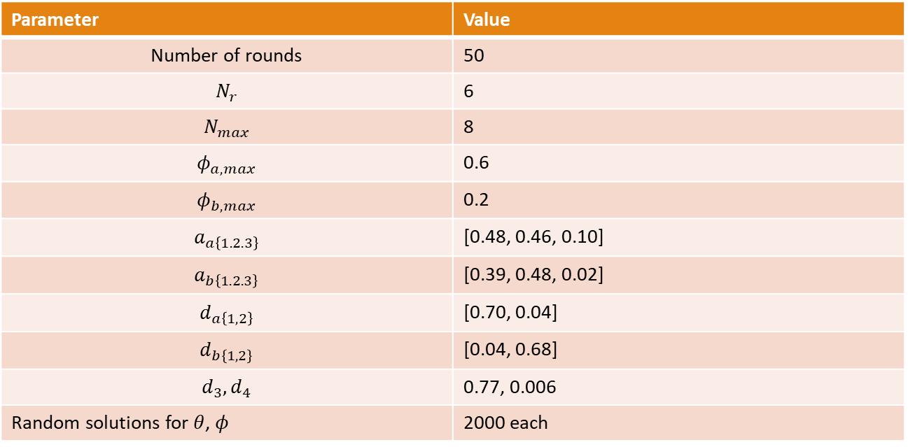
Experiment Setup – Repeated Game
Comparing the NE for the attacker and the defender with 2000 random solutions to verify that the NE yields the maximum payoff, whilst the opponent always chooses the best strategy
Parameter | Value
Number of rounds | 50
$$N_{r}$$ | 6
$$N_{max}$$ | 8
$$φ_{a, max}$$ | 0.6
$$φ_{b, max}$$ | 0.2
$$a_{a\left\{1.2.3\right\}}$$ | [0.48, 0.46, 0.10]
$$a_{b\left\{1.2.3\right\}}$$ | [0.39, 0.48, 0.02]
$$d_{a\left\{1,2\right\}}$$ | [0.70, 0.04]
$$d_{b\left\{1,2\right\}}$$ | [0.04, 0.68]
$$d_{3},d_{4}$$ | 0.77, 0.006
Random solutions for $θ$, $φ$ | 2000 each

Slide 36
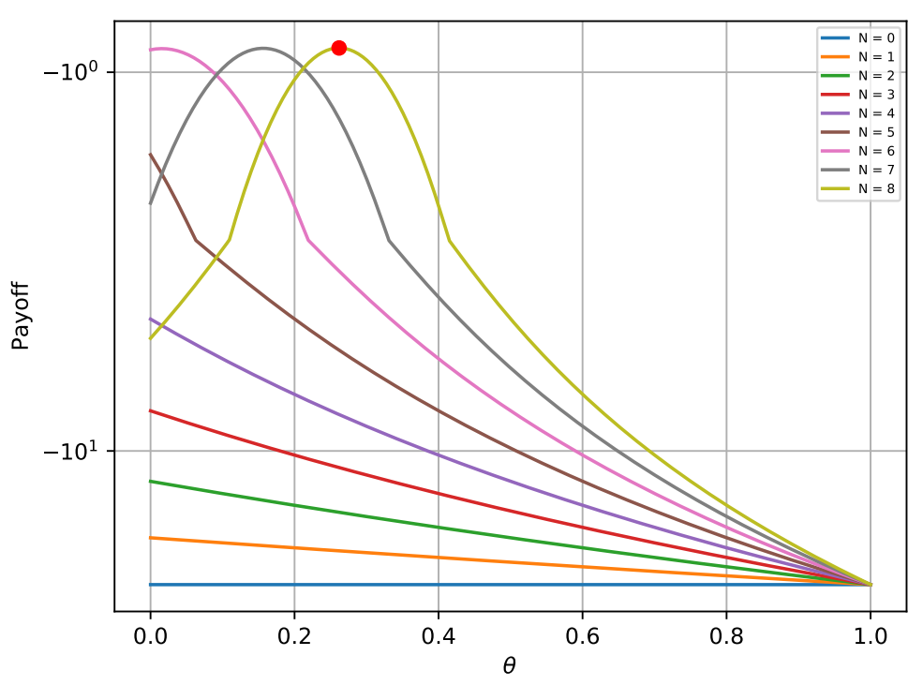

Defender’s Payoff - BNE
Greater N yields better payoff
$N=8$
$θ≅0.38$

Slide 37
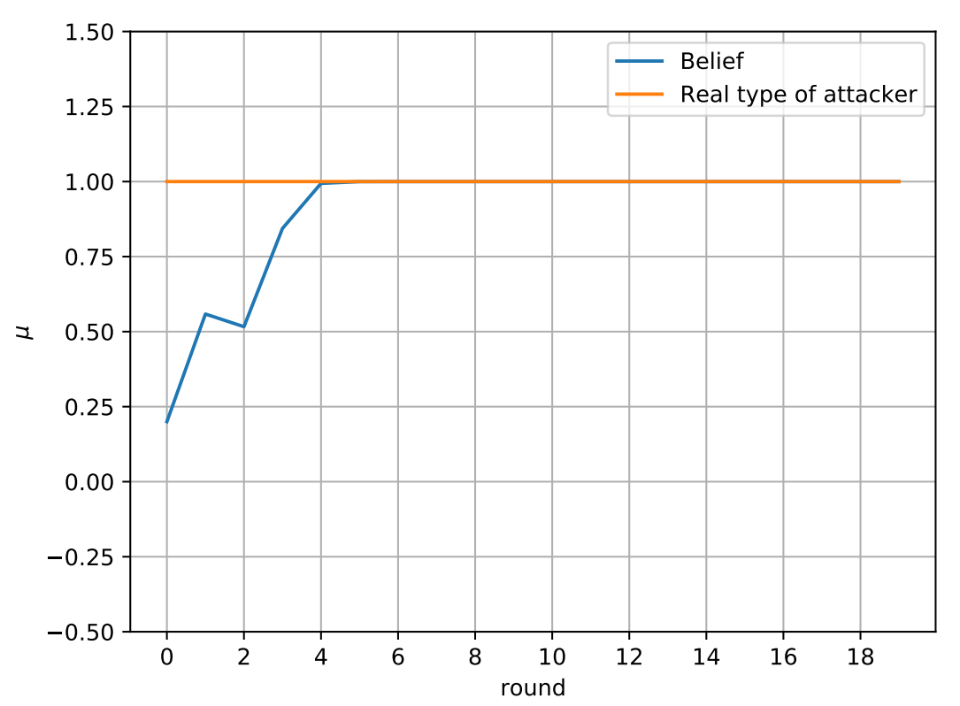
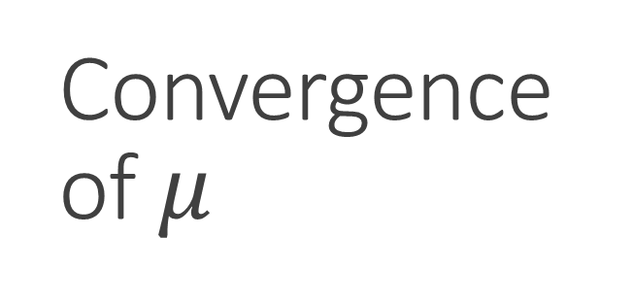

Convergence of $μ$
Compares the belief of the defender VS the actual type of the attacker
Starting point of $μ$ is ~0.24
After 4 rounds, the defender realizes the actual type of attacker

Slide 38
References
P. Diamantoulakis, C. Dalamagkas, P. Radoglou-Grammatikis, P. Sarigiannidis, and G. Karagiannidis, “Game Theoretic Honeypot Deployment in Smart Grid,” Sensors, vol. 20, no. 15, p. 4199, Jul. 2020: https://zenodo.org/record/3967314
N. Nisan, T. Roughgarden, E. Tardos, and V. V. Vazirani, Eds., Algorithmic Game Theory. Cambridge University Press, 2007. (https://www.cs.cmu.edu/~sandholm/cs15-892F13/algorithmic-game-theory.pdf)
C. Dalamagkas, P. Sarigiannidis, S. Kapetanakis and I. Moscholios, “Dynamic scheduling in TWDM-PONs using game theory”, Optical Switching and Networking, Dec. 2017, DOI: 10.1016/j.osn.2017.12.004
C. Dalamagkas et al., A Survey On Honeypots, Honeynets And Their Applications On Smart Grid," in 2019 IEEE Conference on Network Softwarization (NetSoft), 2019. DOI: 10.1109/NETSOFT.2019.8806693.
Design of Market Mechanism for Bandwidth Allocation in XG-PON, https://dspace.uowm.gr/xmlui/handle/123456789/835

